Slide 1
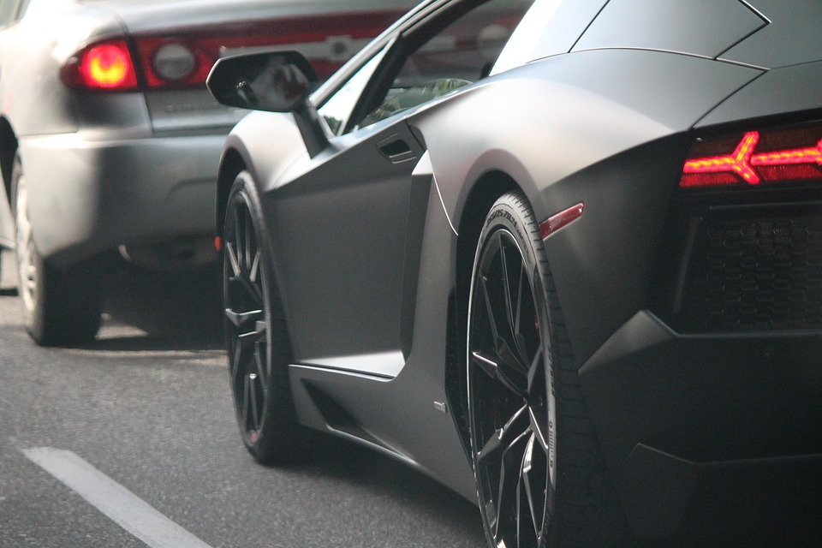
Vehicle resale value prediction

Slide 2
Index
Introduction to Team members
Road map
Conclusion
References

Slide 3
Team Name: BIET-Team 31
Manikanta T
Teaja naidu G
Sindusha P

Slide 4
Introduction
Considering the main factors which would affect the resale value of a vehicle a regression model is to be built that would give the nearest resale value of the vehicle. The main factors are the time in which vehicle got registered, number of KM's it drove, power, type of gear box, model of the car, any damage or repair, fuel type etc. we will be using various regression algorithms and algorithm with the best accuracy will be taken as solution , then it will be integrated to web based application where the user is notified with the status of his product.

Slide 5
Road map
Work distribution
Data collection
Data pre-processing
Model design
Application design

Slide 6
Work distribution
Name: Manikanta T, Teja naidu G, Sindusha P
Work: Data collection, taking car of missing data, splitting data into train and test, training and testing the model, evaluation, creating an HTML file, build python code.
Name: Manikanta T
Work: data visualization, oneHotEncoding.
Name: Teja Naidu G
Work: Import the libraries, label encoding.
Name: Sindusha P
Work: importing dataset, label encoding

Slide 7
Data collection
We have used vehicle scrap value dataset from kaggle provided in the description of the problem.

Slide 8
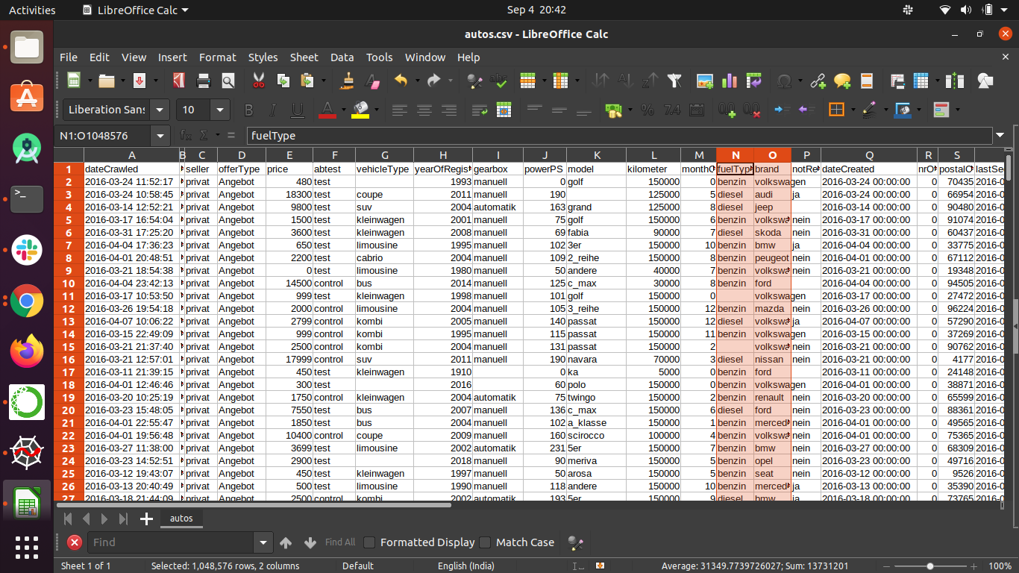
Vehicle resale value dataset

Slide 9
Data pre-processing
importing the libraries
Import the dataset
Data visualization
Taking care of missing data
Label encoding
oneHotEncoding
Feature scaling
Splitting data into train and test

Slide 10
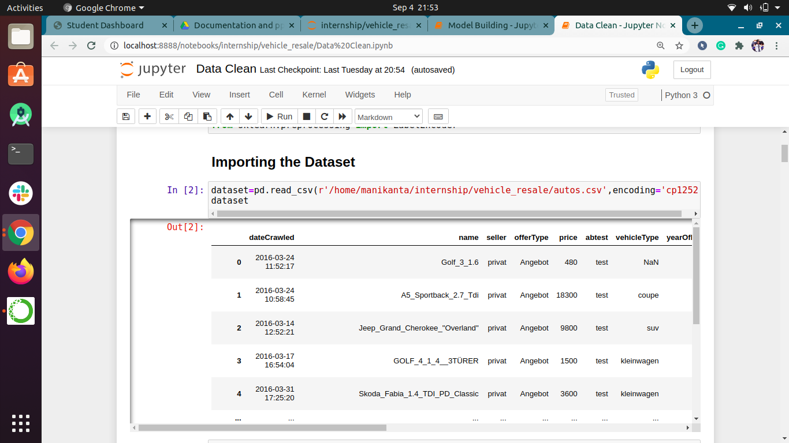
Import the dataset

Slide 11
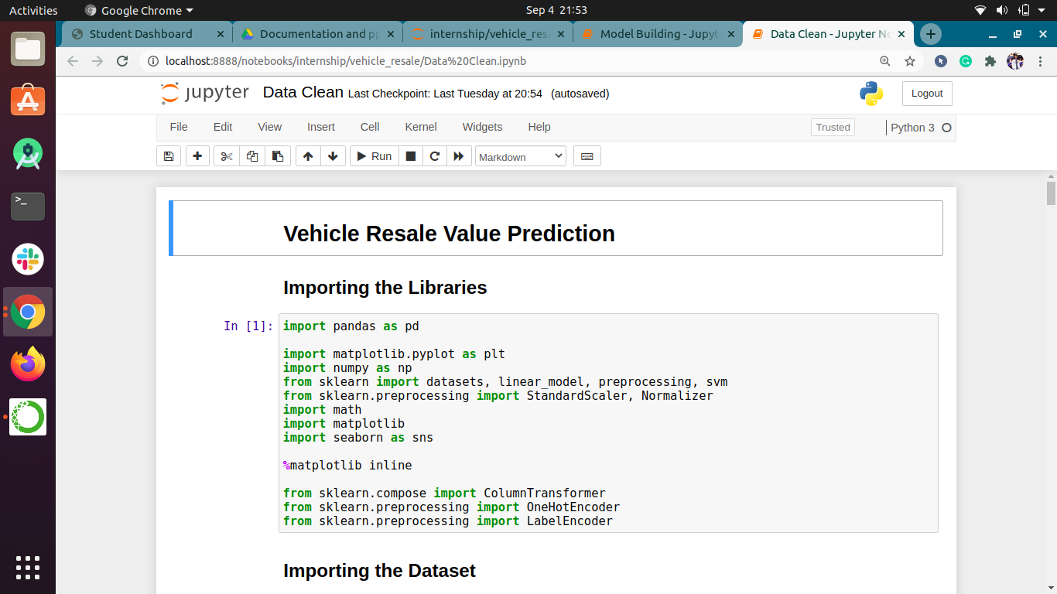
Importing the libraries

Slide 12
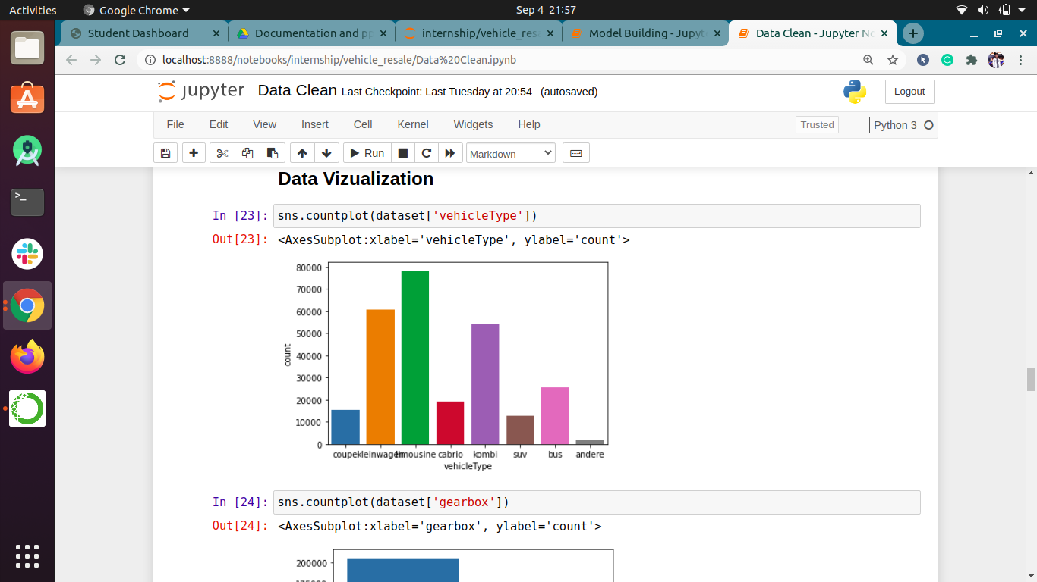
Data visualization

Slide 13
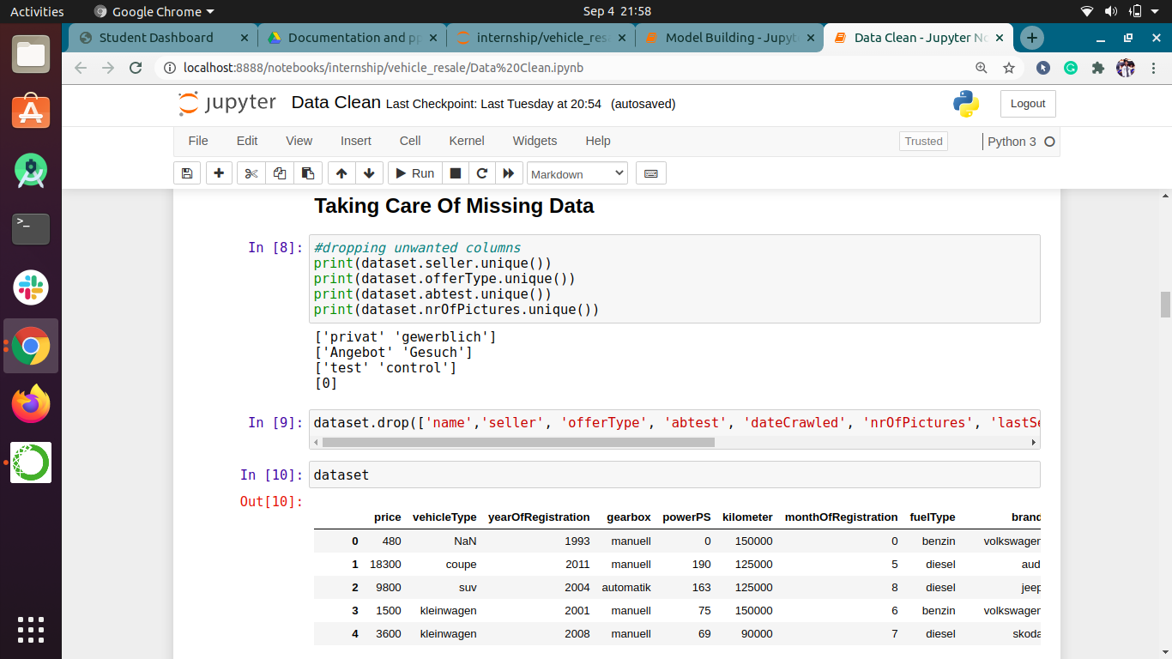
Taking care of missing data

Slide 14
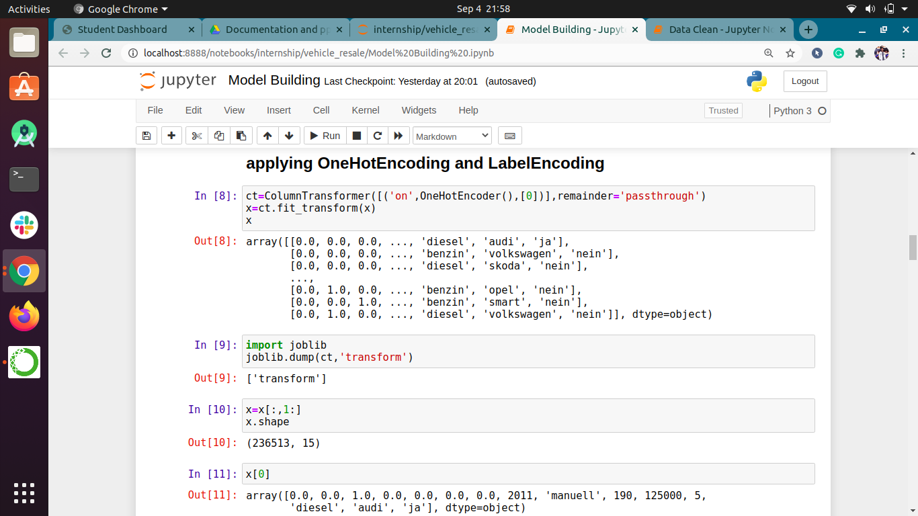
Encoding

Slide 15
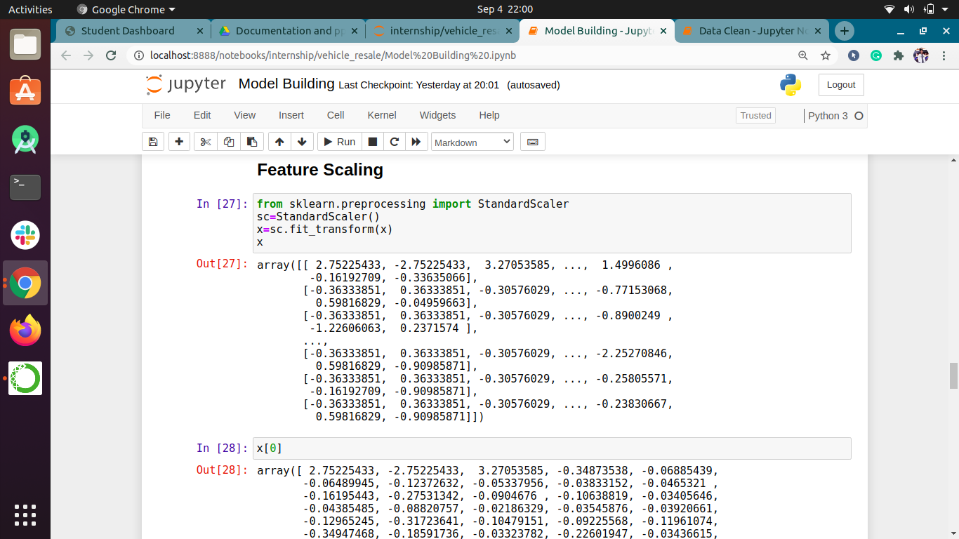
Feature scaling

Slide 16
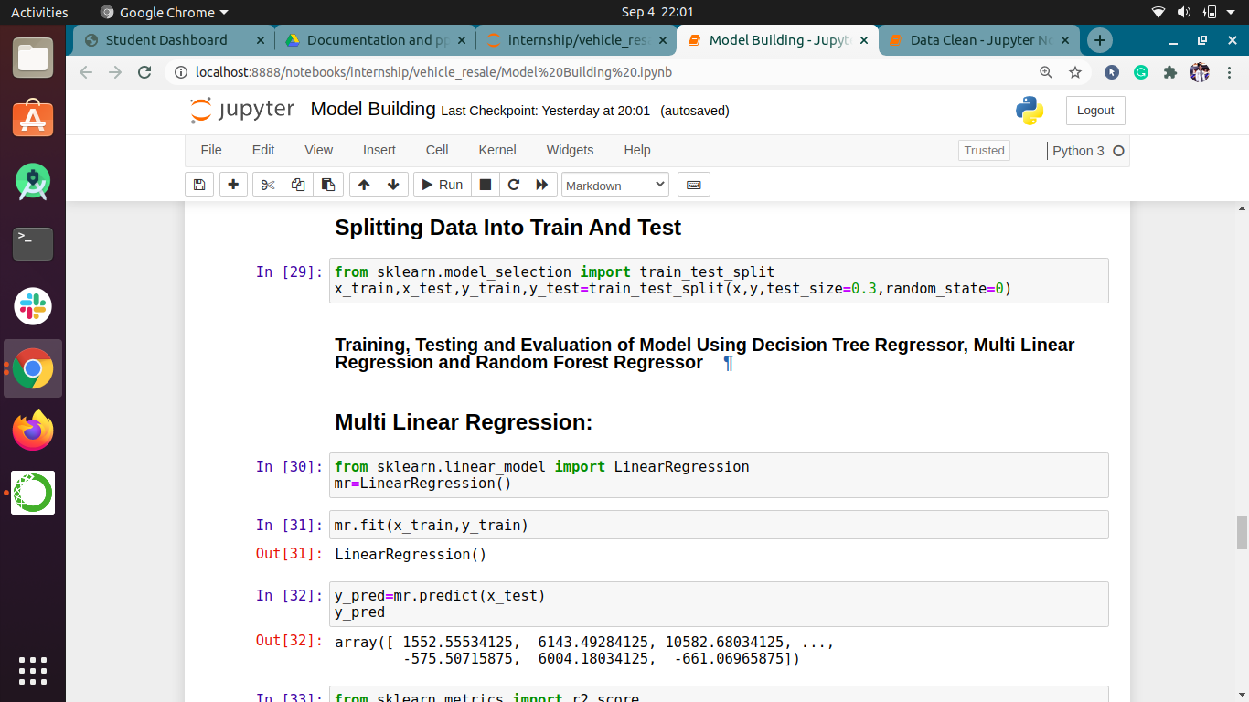
Splitting data into train and test

Slide 17
Model building
We have used different regression algorithms for our model to predict most apropriate value of price of scrap vehicles
We have used multilinear regression, decision tree and random forest algorithms for our model
Random forest algorithm has gives more accuracy

Slide 18
Model building
Steps:
1: training and testing model
2: evaluation

Slide 19
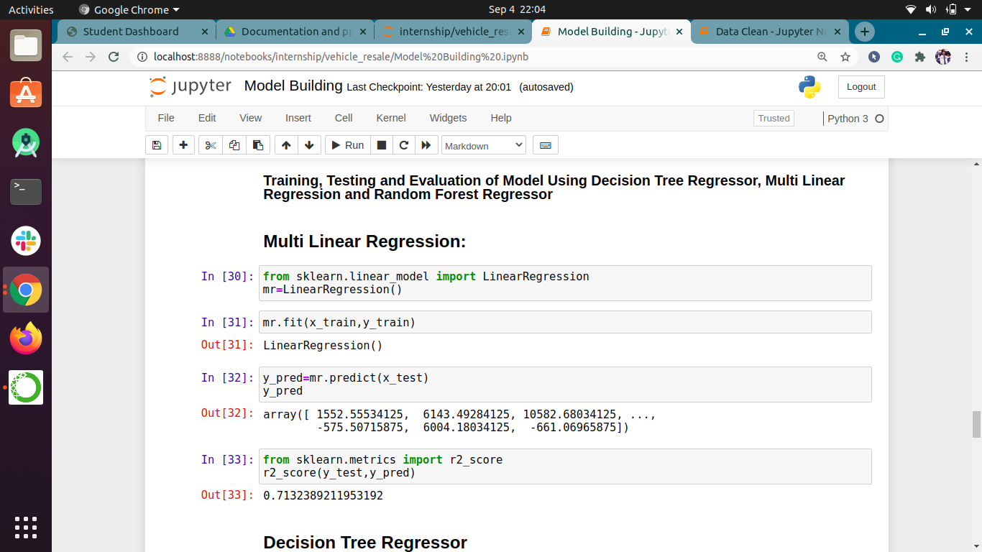
Training and testing model

Slide 20
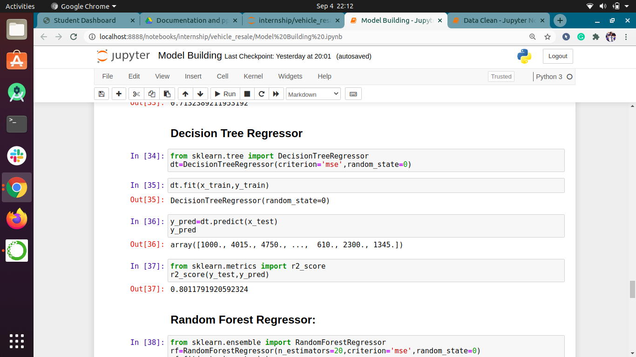

Slide 21
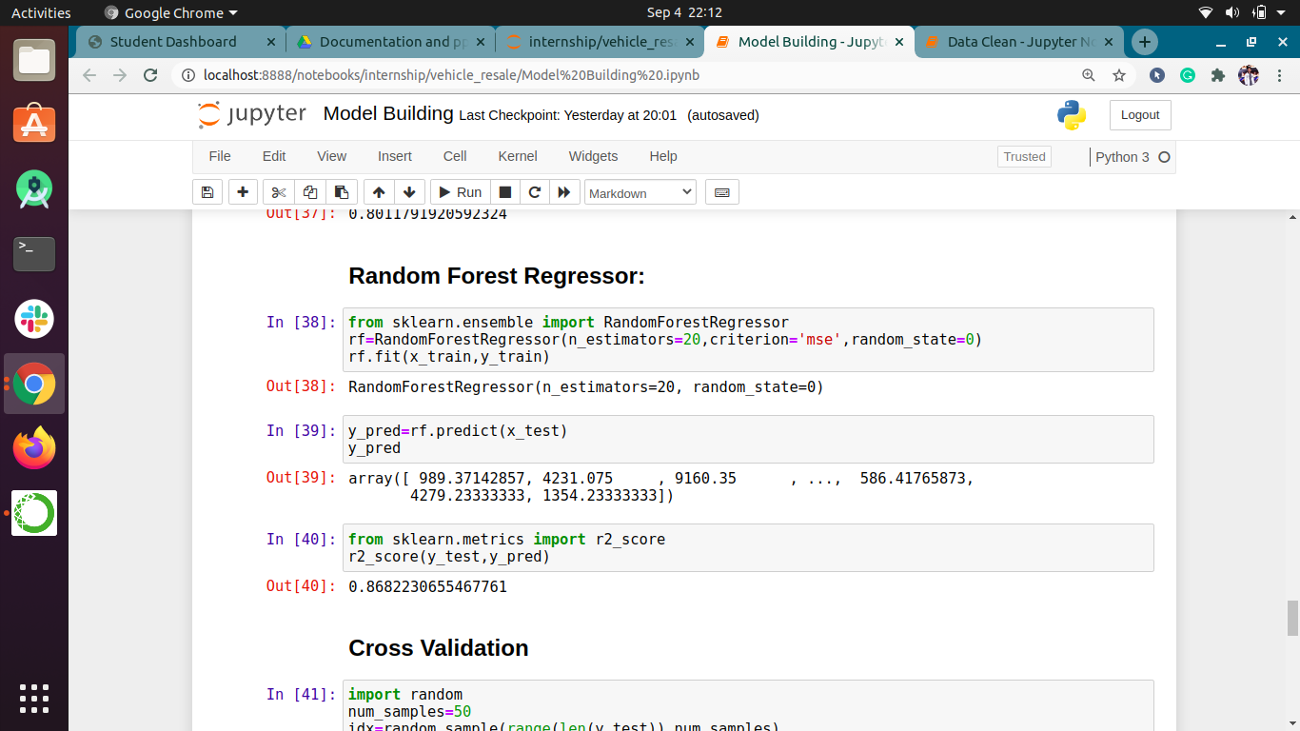

Slide 22
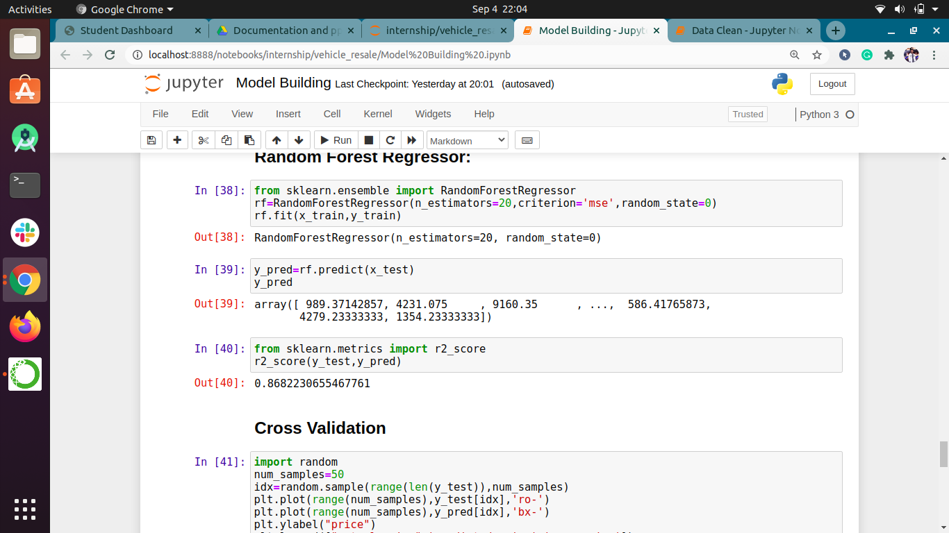
evaluation

Slide 23
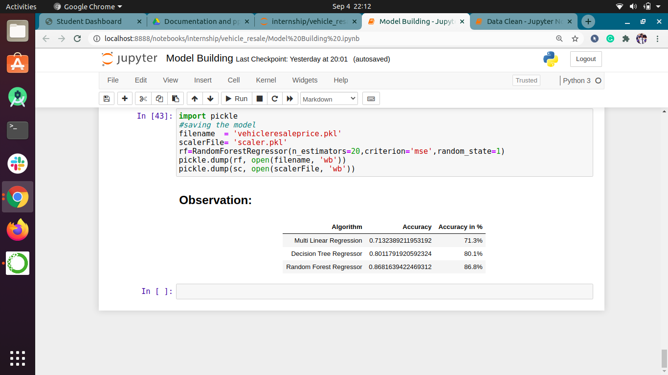

Slide 24
Application building
We have used HTML and CSS for front end and flask for back end
Steps :
1. Create an HTML file
2. Build python code

Slide 25
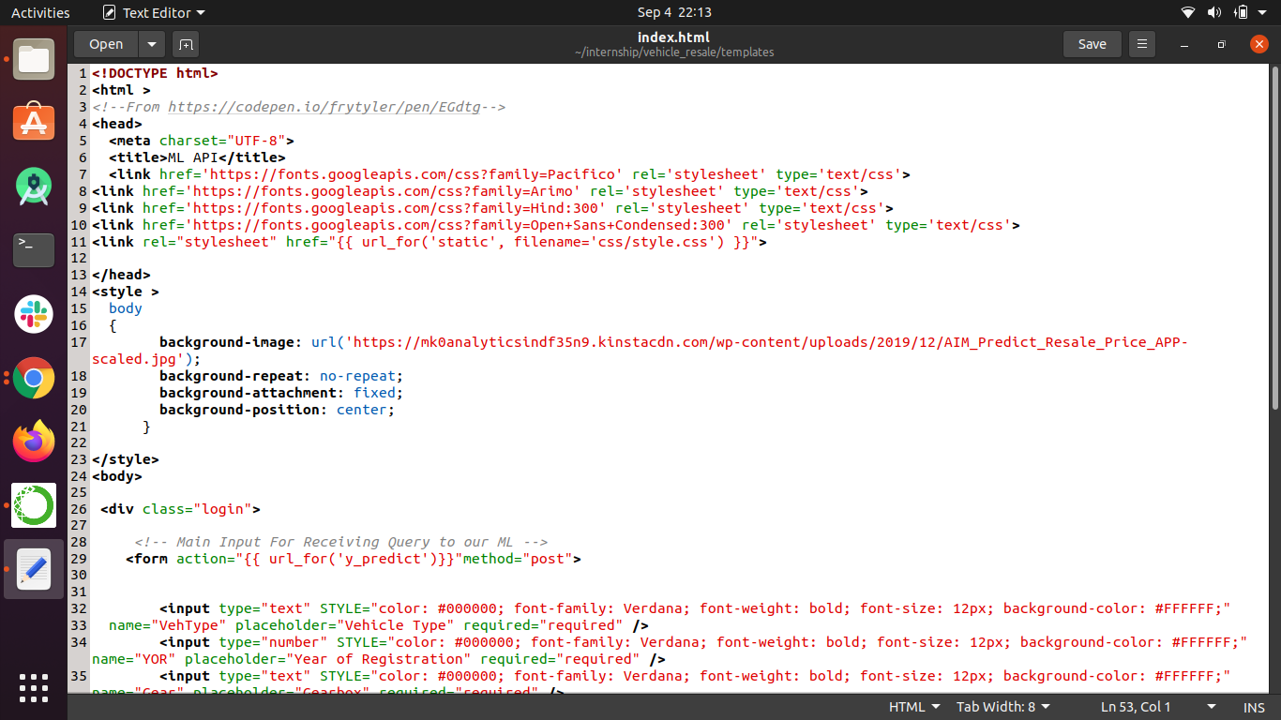
Create an HTML file

Slide 26
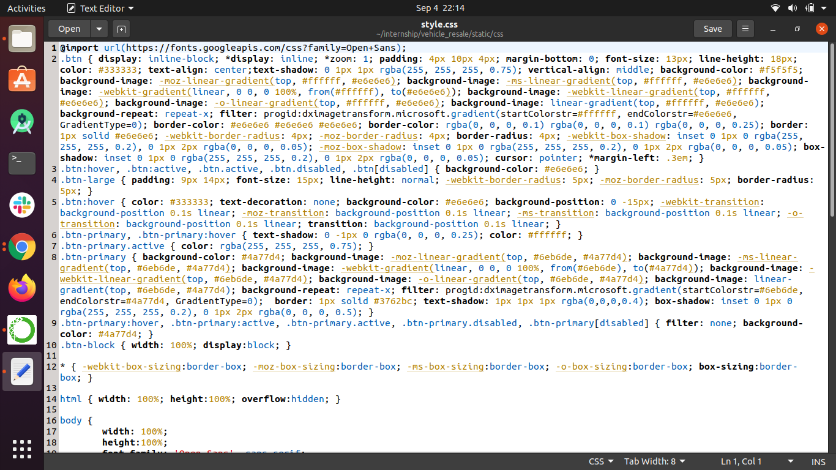
css

Slide 27
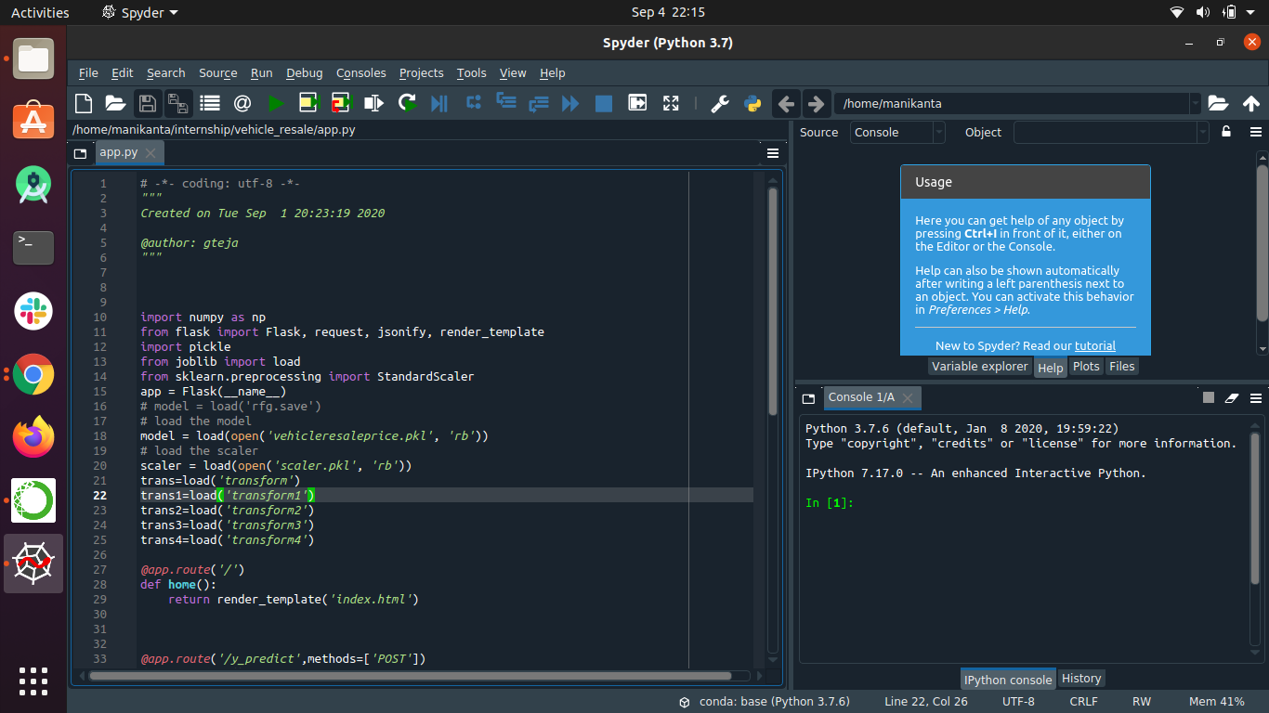
Flask (python code)

Slide 28
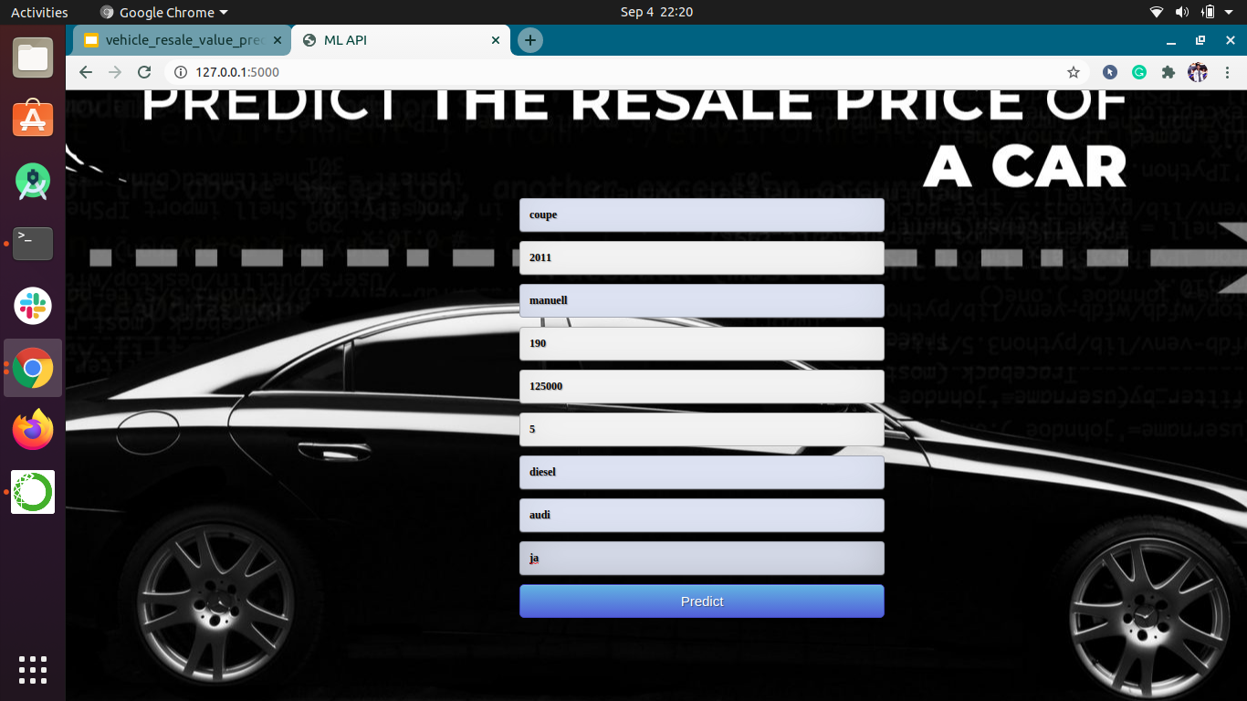
Screenshot of app

Slide 29
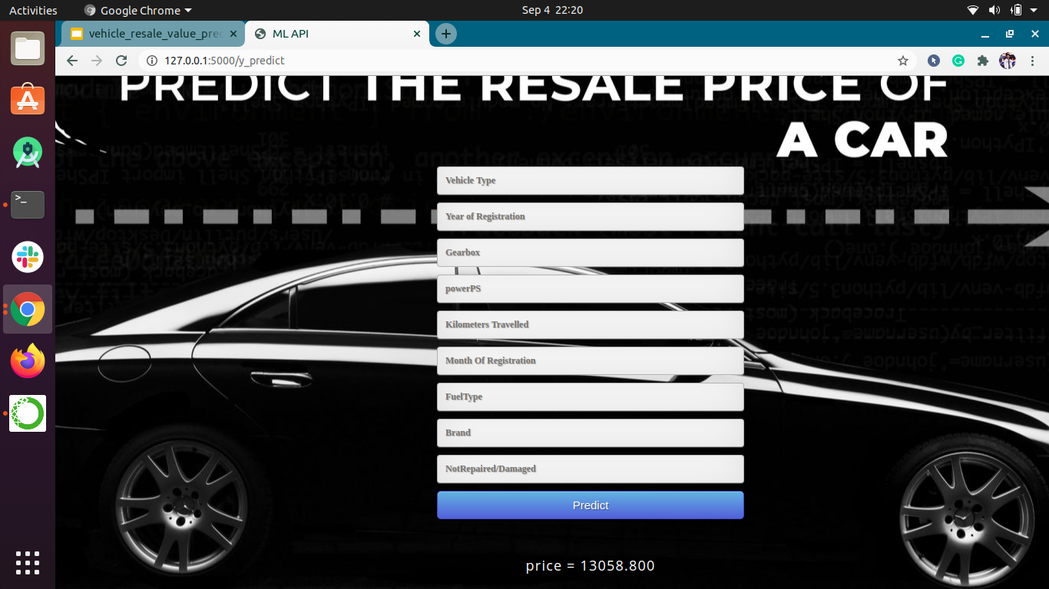
Screenshot of app prediction

Slide 30
conclusion
This projects consists of the details about the model which was used for the prediction of used vehicle price using the data of different vehicles resale values. It is proven that the accuracy of the model has reached good level, if we deploy in real time scenario it will help many people to predict the most accurate resale value of their vehicle

